Slide 1
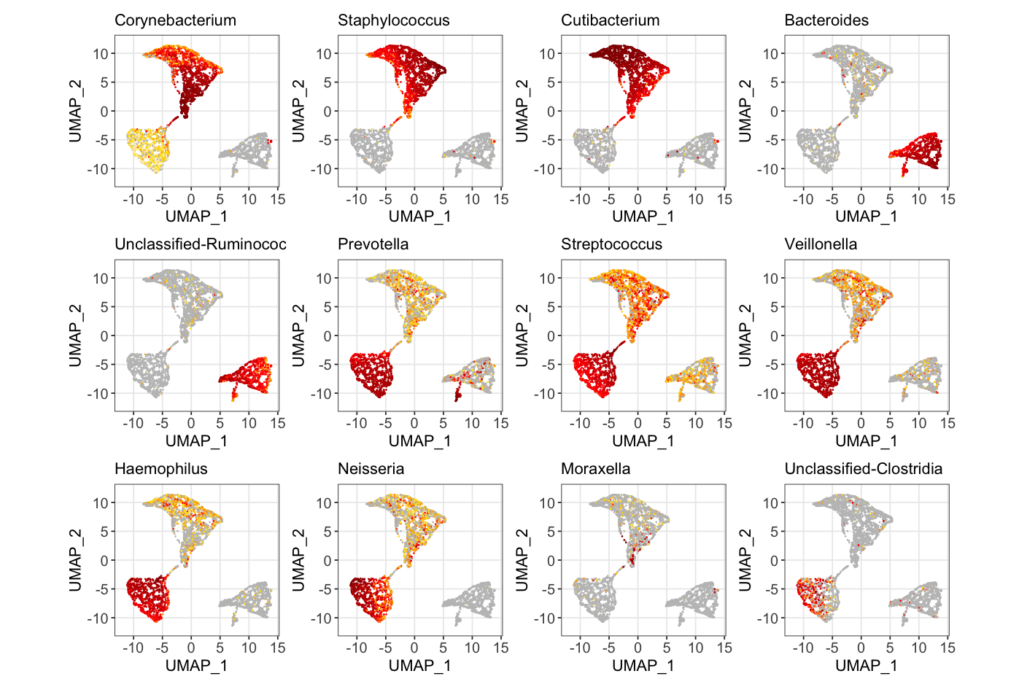
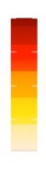
Extended Data Fig. 1: Relative abundance of representative genera on UMAP
Relative Abundance
High
Low
Unclassified Ruminococcaceae

Slide 2
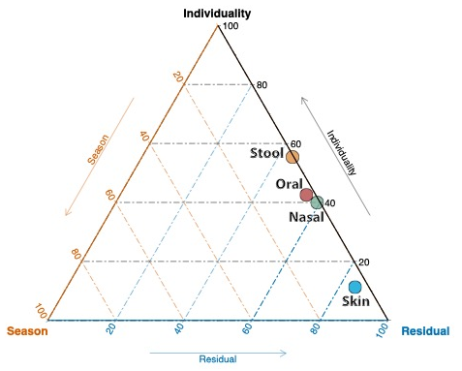
Extended Data Fig. 2: Microbiome variance explained by the Individuality, Season, and Residuals

Slide 3
Extended Data Fig. 3: Microbiome variance explained by exposome in two participants
Participant 1
Participant 2

Slide 4
Extended Data Fig. 4: Diversity and evenness shift between insulin resistance and insulin sensitive individuals
a)
b)
c)
Centroid shift between IR and IS individuals
**
**
*

Slide 5
Extended Data Fig. 5: Prevalence by Relative Abundance Plot

Slide 6
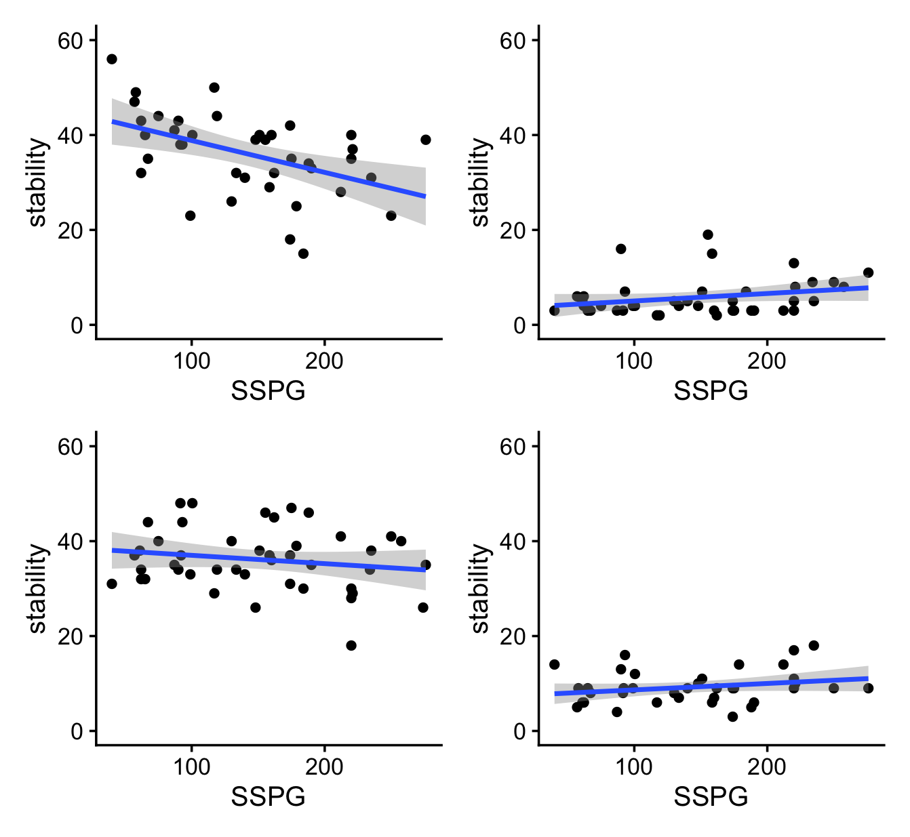
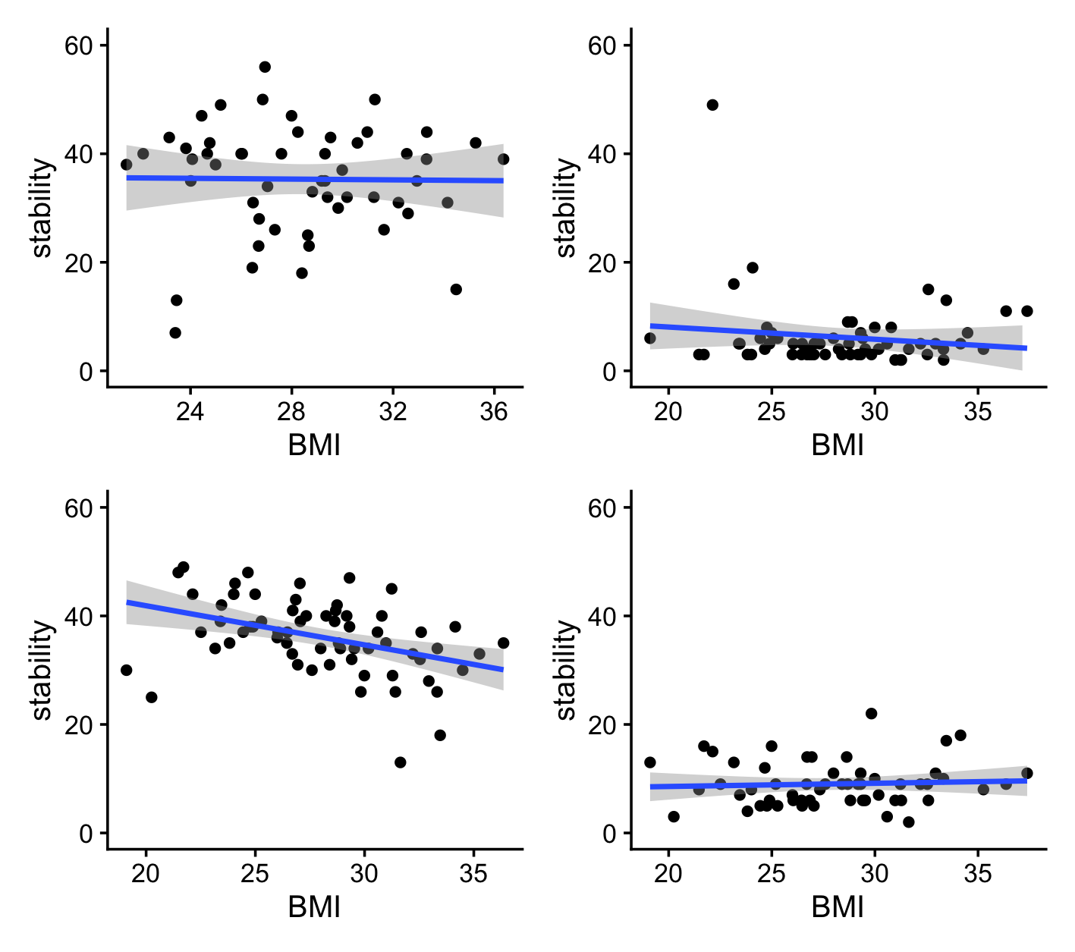
Extended Data Fig. 6: Relationship between number of core microbiome, SSPG, and BMI
a)
b)
**
*
Stool (N =41)
Skin
(N=48)
Stool (N =41)
Skin
(N=48)
S = 12799,
p-value = 0.03483
rho= 0.31
S = 17468,
p-value = 0.00047
rho = -0.52
Observed Number of Core Microbiome
Observed Number of Core Microbiome
Oral
(N=47)
Nasal
(N=40)
**
Nasal
(N=40)
Oral
(N=47)
S = 24253,
p-value = 0.005
rho = -0.40

Slide 7
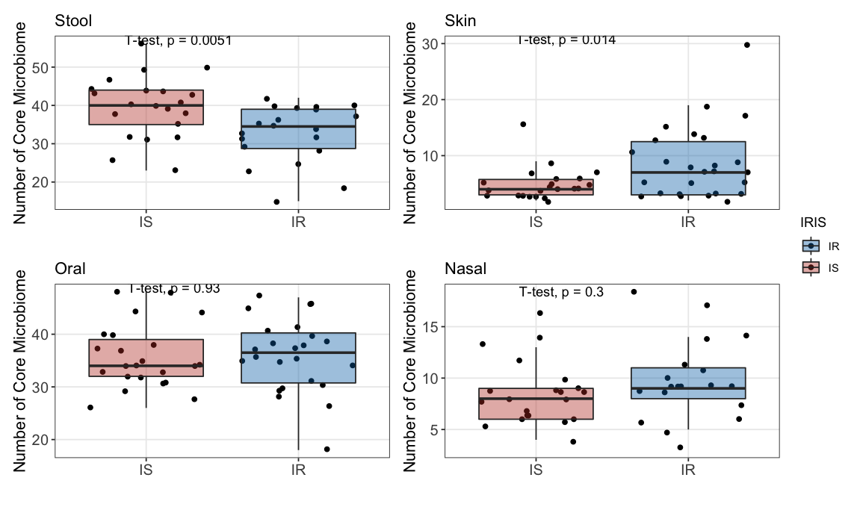
Extended Data Fig. 7: Core Microbiome in IS and IR individuals
a)

Slide 8
b)

Slide 9
Extended Data Fig. 8: Effect size of taxa that are significantly differ in relative abundance between IR and IS individuals
g_Phocaeicola +
related taxonomies
Enriched in IR population
g_Cutibacterium +
related taxonomies
Enriched in IS population
o__Clostridiales
c__Clostridia
Enriched in IR population
f__Peptoniphilaceae
Enriched in IR population
g_Unclassified_Ruminococcaceae +
related taxonomies
Enriched in IS population

Slide 10
Extended Data Fig. 9: Strain replacement rate by body site in IR and IS individuals

Slide 11
Extended Data Fig. 10: Beta coefficient correlation between body sites among IR and IS individuals
a)

Slide 12
b)

Slide 13
Extended Data Fig. 11: Microbiome variance explained by Diet

Slide 14
Extended Data Fig. 12: Beta coefficient comparison between cytokines and genera from different body sites

Slide 15
Extended Data Fig. 13: Phylum Composition of core, middle and opportunistic microbiome

Slide 16
Extended Data Fig. 14: Beta coefficients from stool proteobacteria compared between different prevalence group

Slide 17
Extended Data Fig. 15: BMI is significantly correlated to serum Leptin and GM-CSF level

Slide 18
Extended Data Fig. 16: High collinearity of omics is specific to the lipidome data

Slide 19
Extended Data Fig. 17: Pathway enrichment analysis of proteomics and microbiome interactions
Lipid, sterol and
cholesterol transport
Platelets
activation
Immune regulation
Lipid metabolism
Regulation of Peptidase,
enzyme, proteolysis

Slide 20
Extended Data Fig. 18: Different Interactome of the Stool microbiome and Internal Omics
Proteome
Metabolome
Lipidome
IS
IR

Slide 21
Extended Data Fig. 19: Correlation network of microbiome Richness and multiple internal molecular on four body sites
Lipidome
Proteome
Metabolome

